Slide 1


Project #1 | Process Improvement (Stock Trading)
Class | MBC 638 Data Analysis and Decision Making
Date | August 2022
 | https://github.com/sudz4/syracuse-data-science/blob/c5d096d5ca7f79572f16ae82a820601122427972/proj_1.ipynb

Slide 2





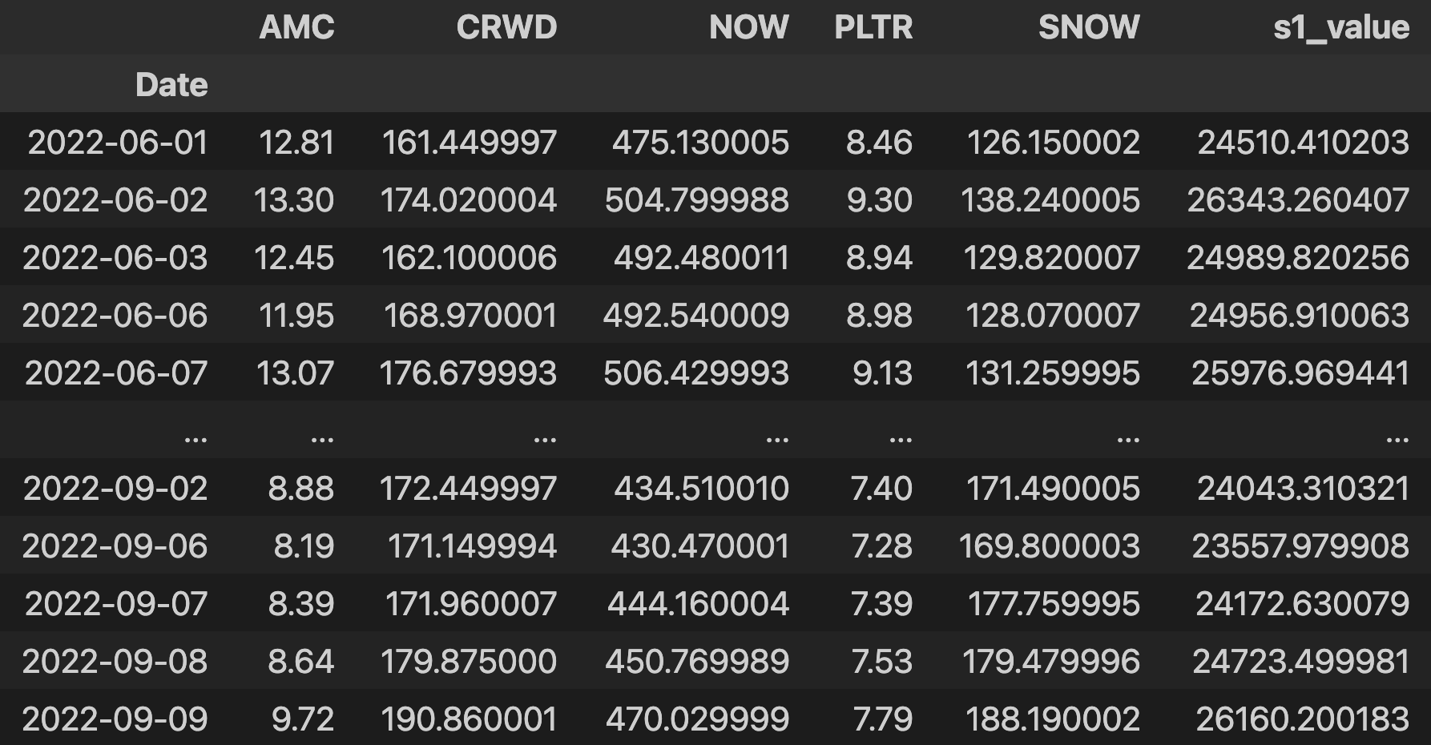


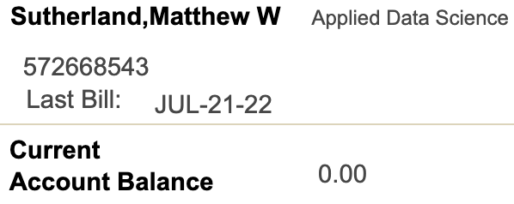







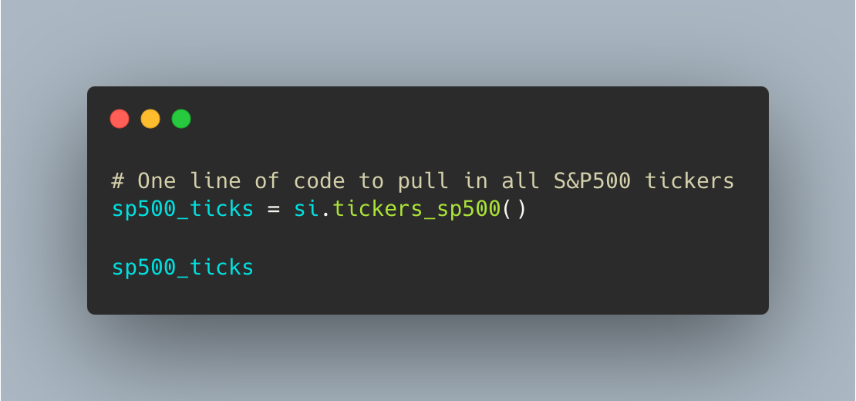




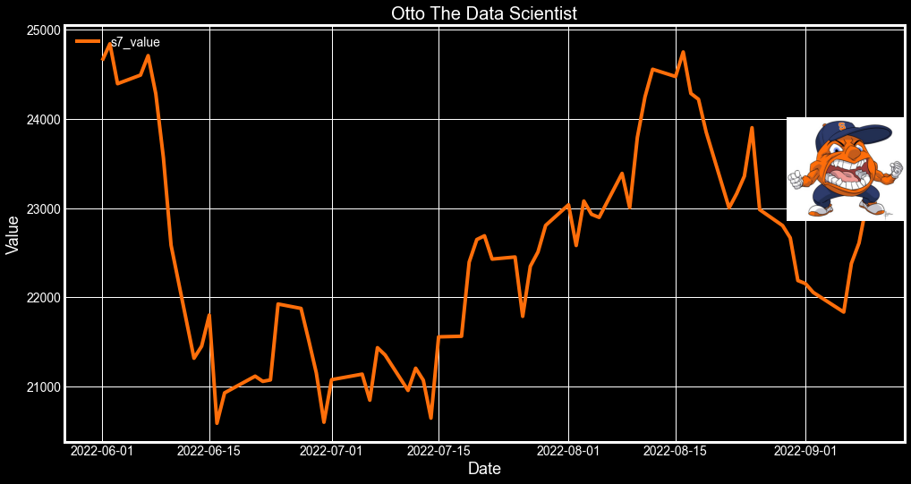


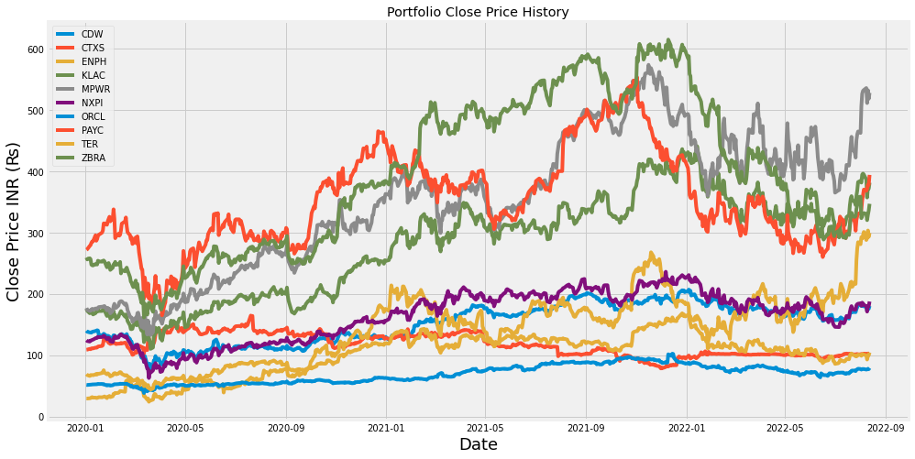

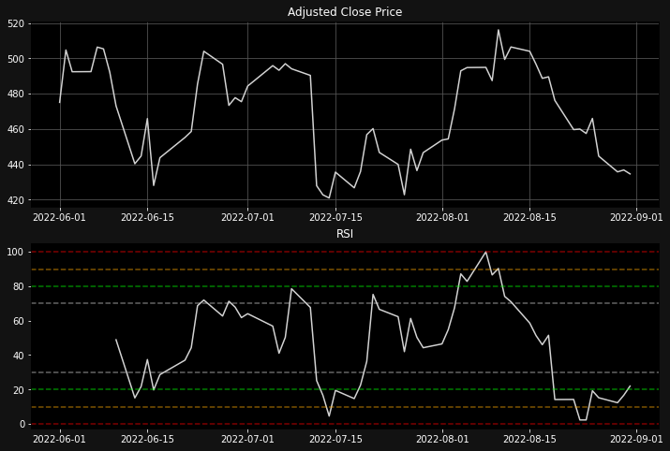

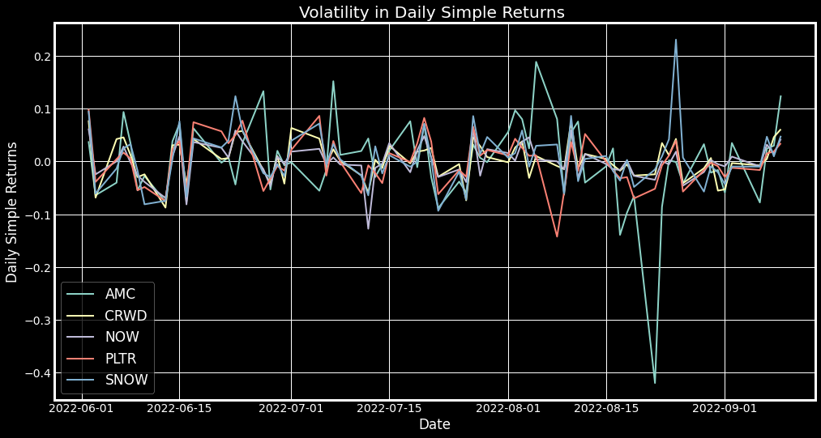





Key Project Dates: Project Initiation – 01JUN22 DEFINE: 11AUG22 MEASURE: 17AUG22 ANALYZE: 27AUG22 IMPROVE: 02SEP22 COVID: 05SEP22 CONTROL: 10SEP22 SEP22 CLOSE (PLANNED): 30SEP22 / (ACTUAL): ????
DEFINE
MEASURE
ANALYZE
Project Delays
Reason: COVID Illness
IMPROVE
*Outstanding bursar bill for final class at Syracuse = $5,406.00
*Just kidding
The problem is that I do not have an effective trading model that will enable me to buy up to 10 stocks while keeping the initial investment to $25,000 or less. All while earning a profit to at least offset some tuition costs. (The ultimate objective, however, is ALL tuition costs covered for the current quarter). *Models are simulations; no actual trades were made to support this project.
The goal is to create a trading model that will enable me to buy up to 10 stocks on *01JUN22 while keeping the initial investment to $25,000 or less, with the objective of selling the shares on 12SEP22* for the current market price. *Timeline*
The metrics that will be used to measure the success of the project are as follows:
-The number of stocks that can be purchased with an initial investment of $25,000 or less.
-The success rate of the trading model (the percentage of stocks that are sold for a profit).
-The amount of money made from the sale of the stocks and the potential longevity and scalability of the model. A research team shall be assembled to work on the project.
*All strategies are buy/hold
Collect, manipulate, and filter S&P 500 stock holdings.
Goal: Select key inputs and implement a focused solution.
Y = f(x1, x2, x3…)
Y is the output / portfolio value at date (d) or the sell date.
Y is a function of the variable {x} inputs that the trader uses to create and (back)test the trading models / strategies.
The highest return with the best selection of stocks wins *within the pre-determined time frame.
Models:
Tools Used:
Correlation
Scatter Plot
Times Series Charts
Donut Charts
Process Control Chart
Simple Linear Regression
Discrete & Continuous Data
Simple Returns % Averages
Moving % Averages & Percentile Scoring
Compare cumulative returns across trading strategies.
S1: |Results: +$1,650 | Mission Status: Fail
S2: | Results: -$4752 | Mission Status: Fail
S3: | Results: +$24 | Mission Status: Fail
S4: | Results: +$331 | Mission Status: Fail
S5: | Results: +$5873 | Mission Status: Success!
S7: | Results: -$1800 (~) Mission Status: Fail
SX: | Data Exploration and understanding
CI/CD DevOps Pipe-Line
Ho : two-year-price-return has a significant impact on stock price.
Ha : two-year-price-return is not significant.
P-value = 0.12
Accept the null hypothesis with the caveat that the stocks are filtered earlier in the data analysis process. The assumption is that the calculations are accurate or nearly accurate.
CONTROL
(CVS) COMPOSIT VALUE SCORE
5.5%
6.0%
8.0%
8.3%
8.7%
Project Manager
Matt
CORRELATION | VARIABLE
0.444784082 | one-year-price-return
0.238819684 | one-year-price-return-percentile
0.415307281 | two-year-price-return-percentile
0.483997751 | two-year-price-return
Visuals UI Designer
Matt
Stock Market Researcher
Matt
Programmer Matt
Data Analyst
Matt

Slide 3
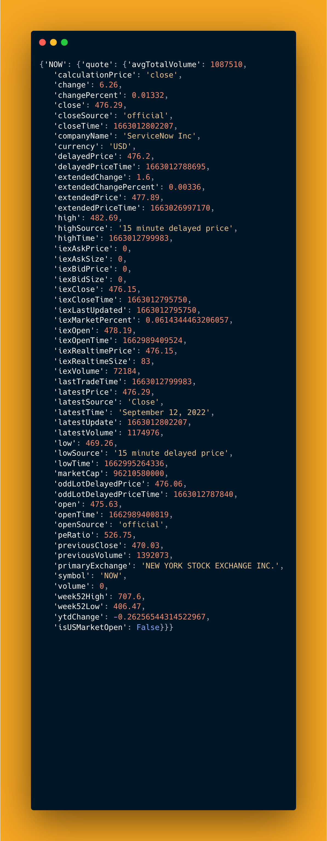
DESCRETE Data
ticker | latest_price | two-year-price-return | two-year-price-return-percentile | one-year-price-return
AJG | 187.63 | 0.900956935 | 87.87276342 | 0.32376353
ALB | 296.97 | 2.221778999 | 97.81312127 | 0.254120975
CEG | 88.13 | 0.663296105 | 79.32405567 | 0.663296105
ENPH | 308.93 | 3.695852535 | 99.20477137 | 0.932119833
GPC | 163.15 | 0.709651233 | 82.30616302 | 0.411492567
MCK | 363.73 | 1.471259404 | 96.02385686 | 0.815991796
NLSN | 27.86 | 0.964614376 | 90.45725646 | 0.415808678
ON | 71.9 | 2.321900348 | 98.40954274 | 0.528470889
PFG | 79.78 | 1.056896343 | 92.24652087 | 0.251648694
PWR | 145.66 | 1.861716835 | 96.81908549 | 0.270202855
3rd Party Data Sources

Slide 4
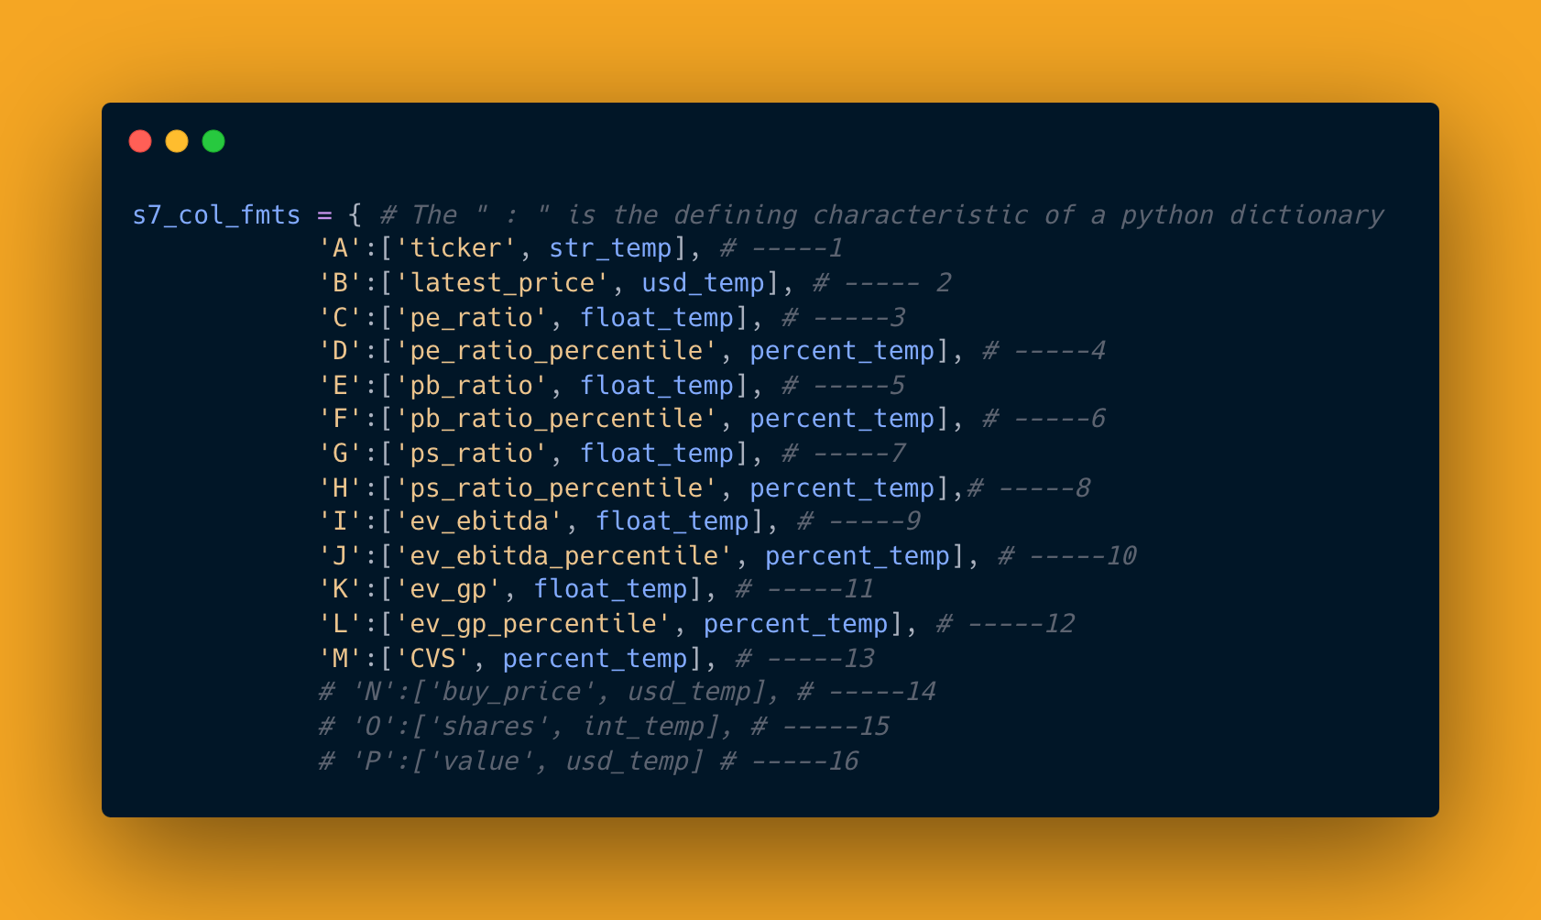
Automate Excel Formatting
Continuous Data
Date | AJG | ALB | CEG | ENPH | GPC | MCK | NLSN | ON | PFG | PWR | s5_value
2022-06-01 00:00:00 | 160.51 | 240.12 | 63.65 | 182.49 | 135.82 | 322.21 | 25.43 | 59.27 | 71.6 | 119.78 | 24175.28
2022-06-02 00:00:00 | 164.37 | 251.29 | 63.75 | 198.93 | 136.78 | 318.58 | 25.67 | 63.59 | 72.19 | 124.57 | 24875.19
2022-06-03 00:00:00 | 162.21 | 250.76 | 65.17 | 196.34 | 135.95 | 316.38 | 25.37 | 62.94 | 70.88 | 129.12 | 24818.62
2022-06-06 00:00:00 | 162 | 257.79 | 66.39 | 206.97 | 139.66 | 317.66 | 25.34 | 66.01 | 71.73 | 131.4 | 25347.78
2022-06-07 00:00:00 | 163.56 | 257.89 | 66.55 | 209.63 | 140.81 | 321.65 | 25.57 | 65.48 | 72.2 | 133.74 | 25524.69
2022-06-08 00:00:00 | 161.18 | 253.62 | 64.77 | 204.77 | 139.46 | 315.02 | 25.43 | 63.81 | 71.62 | 130.44 | 25073.4
2022-06-09 00:00:00 | 156.96 | 241.78 | 61.21 | 200.51 | 139.59 | 312.03 | 24.97 | 62.66 | 70.29 | 130.76 | 24546.69
2022-06-10 00:00:00 | 153 | 236.87 | 59.79 | 196.19 | 135.93 | 313.34 | 24.4 | 60.14 | 66.33 | 126.6 | 23890.4
2022-06-13 00:00:00 | 151.58 | 222.22 | 55.48 | 178.24 | 131.61 | 306.99 | 23.26 | 56.07 | 63.59 | 125.81 | 22807.33
2022-06-14 00:00:00 | 153.23 | 223.33 | 54.44 | 179.52 | 132.44 | 306.52 | 22.52 | 56.65 | 63.94 | 123.55 | 22749.45
2022-06-15 00:00:00 | 152.75 | 215.08 | 58.2 | 188.48 | 132.42 | 307.68 | 22.65 | 58.04 | 64.96 | 124.12 | 23047.83
2022-06-16 00:00:00 | 149.05 | 202.17 | 58.26 | 169.6 | 128.31 | 304.02 | 21.72 | 53.46 | 62.84 | 114.73 | 21977.15
2022-06-17 00:00:00 | 149.71 | 212.04 | 58.1 | 184.75 | 127.22 | 300.57 | 22.41 | 52.46 | 63.86 | 113.85 | 22275.39
2022-06-21 00:00:00 | 155.21 | 216.33 | 60.38 | 193.29 | 130.81 | 309.38 | 22.92 | 51.95 | 65.48 | 119.23 | 22918.26
2022-06-22 00:00:00 | 157.31 | 216.24 | 59.21 | 193.43 | 131.62 | 311.05 | 23.03 | 51.01 | 65.51 | 118.86 | 22896.24
3rd Party Data Sources

Slide 5
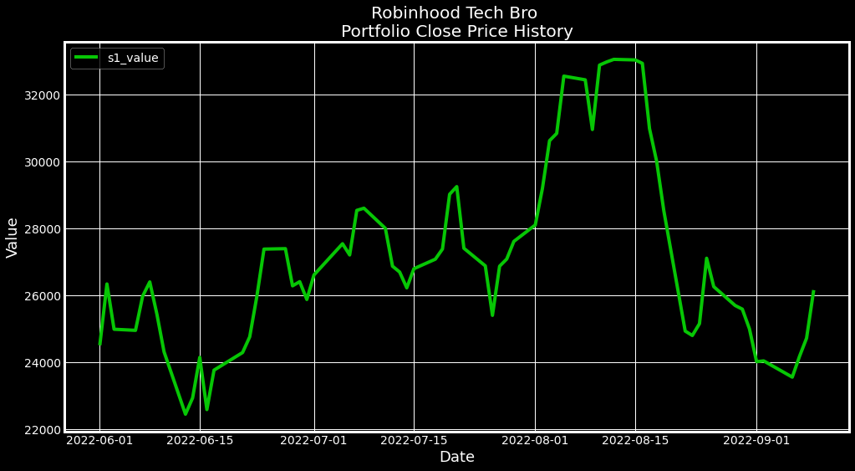

Robinhood / r/Wallstreetbets Trading Strategy
SMALL

Slide 6
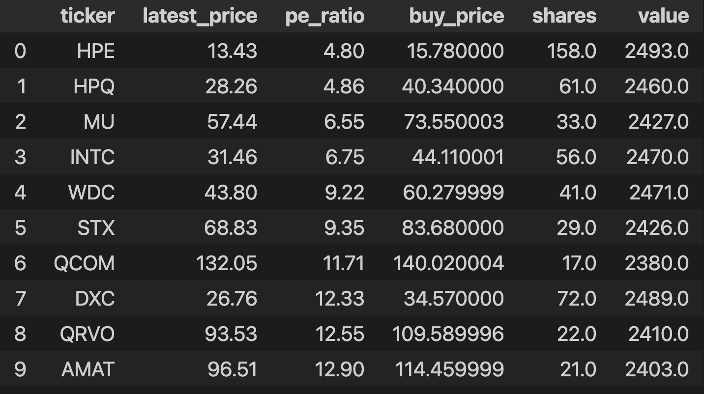
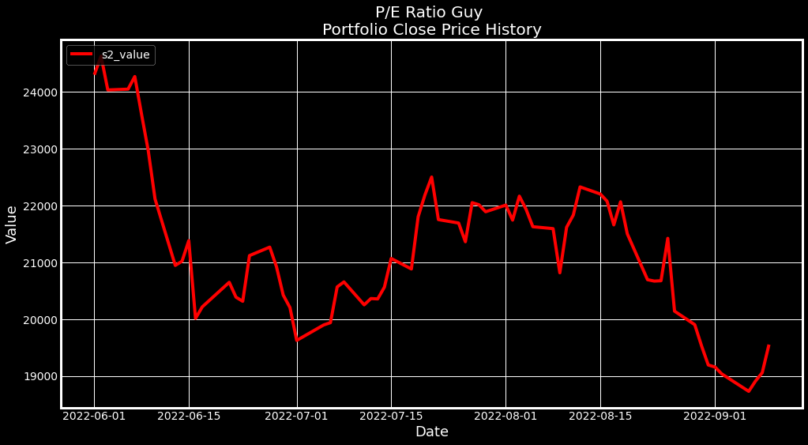
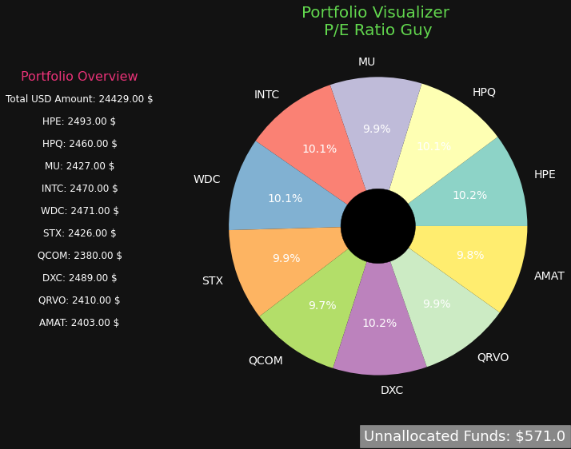
Price to Earnings (P/E) Ratio Strategy
SMALL

Slide 7
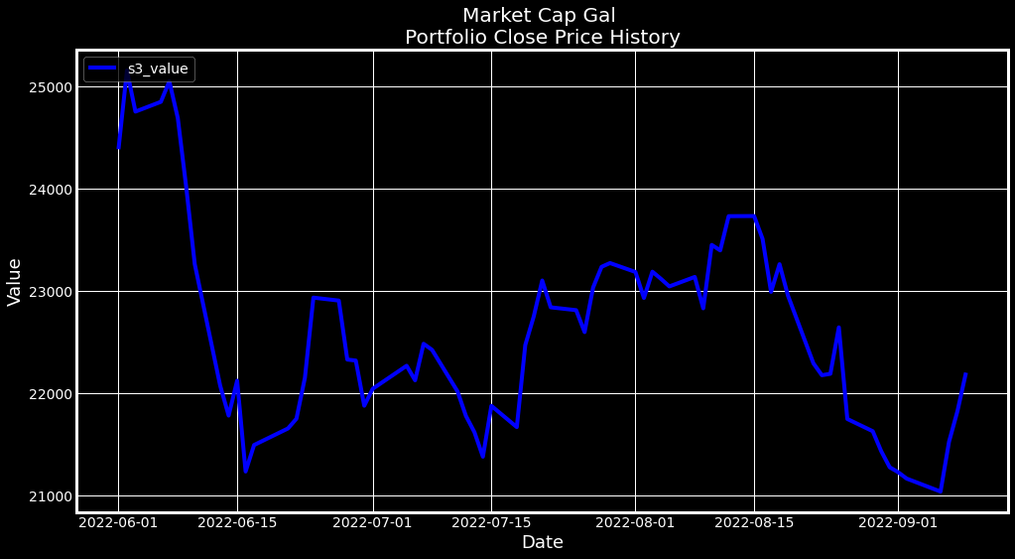
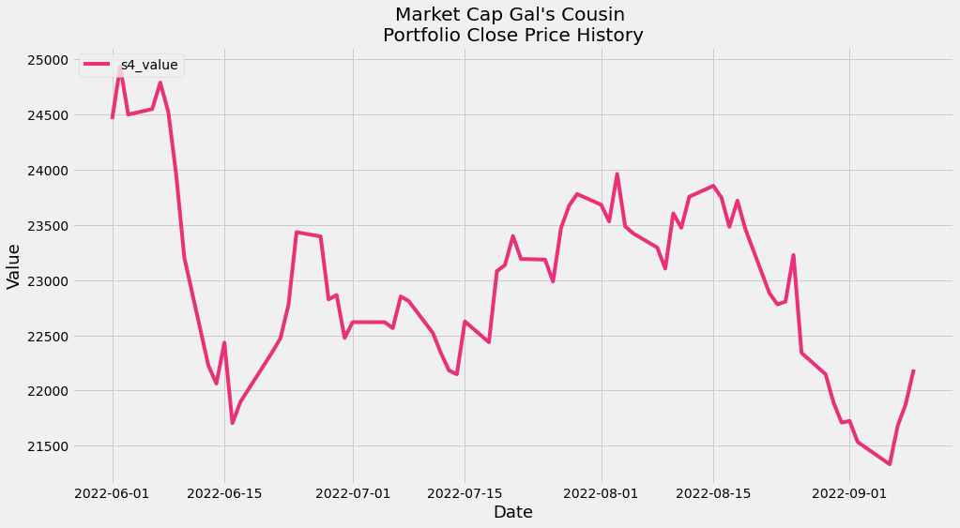
Market Cap Strategy
All stocks with lowest market cap (higher risk)
Market Capitalization:
(Market Cap) is a measurement of business value based on share price and number of shares outstanding.
It generally represents the market's view of a company's stock value and is a determining factor in stock valuation.
For example, if a company has 1.5 million shares outstanding and trade at $90 per share, its market capitalization would be $1.35 billion.
Is a higher or lower market cap better?
There is no definitive answer to this question as it depends on individual circumstances and preferences. Some investors may prefer to invest in companies with lower market capitalizations because they believe these companies are more likely to experience high growth rates. Others may prefer to invest in companies with higher market capitalizations because they tend to be more stable and have a lower risk of default.
SMALL
Split 50/50 between high and low market cap stocks (attempted risk hedging).

Slide 8
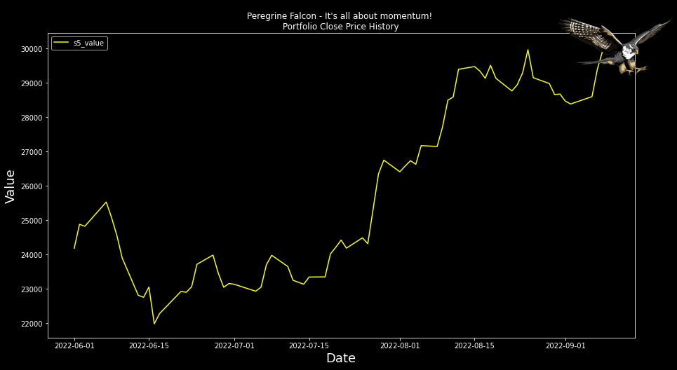
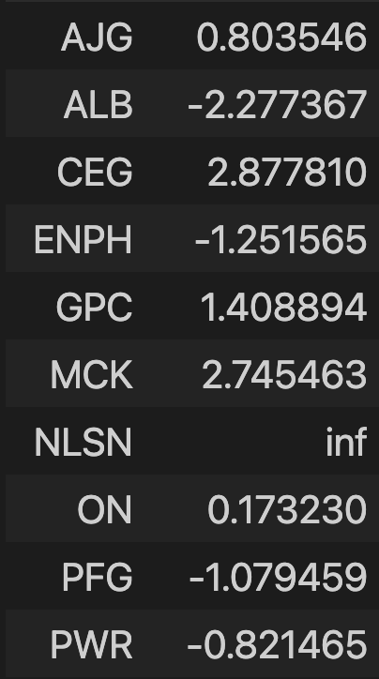
Peregrine Falcon – High Quality Momentum (HQM) Strategy
Best Performing Trading Strategy
Simple Returns – Daily Average
SMALL
The peregrine falcon (and the cheetah) have the highest kinetic energy (aka “momentum”) in the animal kingdom.
What is a high-quality momentum stock versus a low-quality momentum stock?
A high-quality momentum stock is a stock that is experiencing a sustained increase in price and volume.
A low-quality momentum stock is a stock that is experiencing a short-term increase in price and volume.

Slide 9
High Quality Momentum Score (HQM)
ticker | latest_price | two-year-price-return | two-year-price-return-percentile | one-year-price-return | one-year-price-return-percentile | six-month-price-return | six-month-price-return-percentile | three-month-price-return | three-month-price-return-percentile | hqm_score
AJG | 187.63 | 0.900956935 | 87.87276342 | 0.32376353 | 89.86083499 | 0.233908179 | 96.02385686 | 0.234972491 | 95.8250497 | 92.39563
ALB | 296.97 | 2.221778999 | 97.81312127 | 0.254120975 | 88.07157058 | 0.631636928 | 99.40357853 | 0.268079537 | 98.01192843 | 95.82505
CEG | 88.13 | 0.663296105 | 79.32405567 | 0.663296105 | 96.42147117 | 0.781889116 | 99.60238569 | 0.466244213 | 99.80119284 | 93.78728
ENPH | 308.93 | 3.695852535 | 99.20477137 | 0.932119833 | 98.6083499 | 0.786987783 | 99.80119284 | 0.558183394 | 100 | 99.40358
GPC | 163.15 | 0.709651233 | 82.30616302 | 0.411492567 | 93.0417495 | 0.354470168 | 98.80715706 | 0.204585713 | 93.43936382 | 91.89861
MCK | 363.73 | 1.471259404 | 96.02385686 | 0.815991796 | 97.61431412 | 0.30410722 | 98.40954274 | 0.170466691 | 89.26441352 | 95.32803
NLSN | 27.86 | 0.964614376 | 90.45725646 | 0.415808678 | 93.43936382 | 0.598311045 | 99.20477137 | 0.144293524 | 85.28827038 | 92.09742
ON | 71.9 | 2.321900348 | 98.40954274 | 0.528470889 | 95.22862823 | 0.282340311 | 97.61431412 | 0.191719322 | 92.04771372 | 95.82505
PFG | 79.78 | 1.056896343 | 92.24652087 | 0.251648694 | 87.87276342 | 0.224534485 | 95.62624254 | 0.190548604 | 91.84890656 | 91.89861
PWR | 145.66 | 1.861716835 | 96.81908549 | 0.270202855 | 88.46918489 | 0.191401065 | 93.63817097 | 0.1599197 | 88.46918489 | 91.84891
Ho : two-year-price has a significant impact on stock price.
Ha : two-year-price return is not significant.
P-value = 0.12
Accept the null hypothesis with the caveat that.
The selected stocks are filterd from other calculations.
The assumption is that the calculations are accurate or nearly accurate.
SMALL
P-value
0.122160722
0.15883357
CORRELATION | VARIABLE
0.444784082 | one-year-price-return
0.238819684 | one-year-price-return-percentile
0.415307281 | two-year-price-return-percentile
0.483997751 | two-year-price-return

Slide 10

Otto The Data Scientist – Change % Score Modelling / Combining Continuous & Discrete Data
Do negative price to book ratios mean that a company is buying back stock and diluting shares?
No, a negative price to book ratio does not necessarily mean that a company is buying back stock and diluting shares. It could be indicative of other factors, such as the company being in a high-growth industry.
SMALL
What do negative price to book ratios indicate?
Negative price to book ratios indicate that a company's stock price is trading below its book value. This may be due to a variety of reasons, such as the company being in financial distress or having poor prospects for future growth.

Slide 11
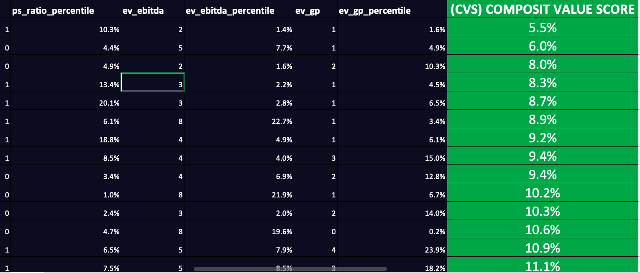
Composite Value Percentile Scores
SMALL

Slide 12
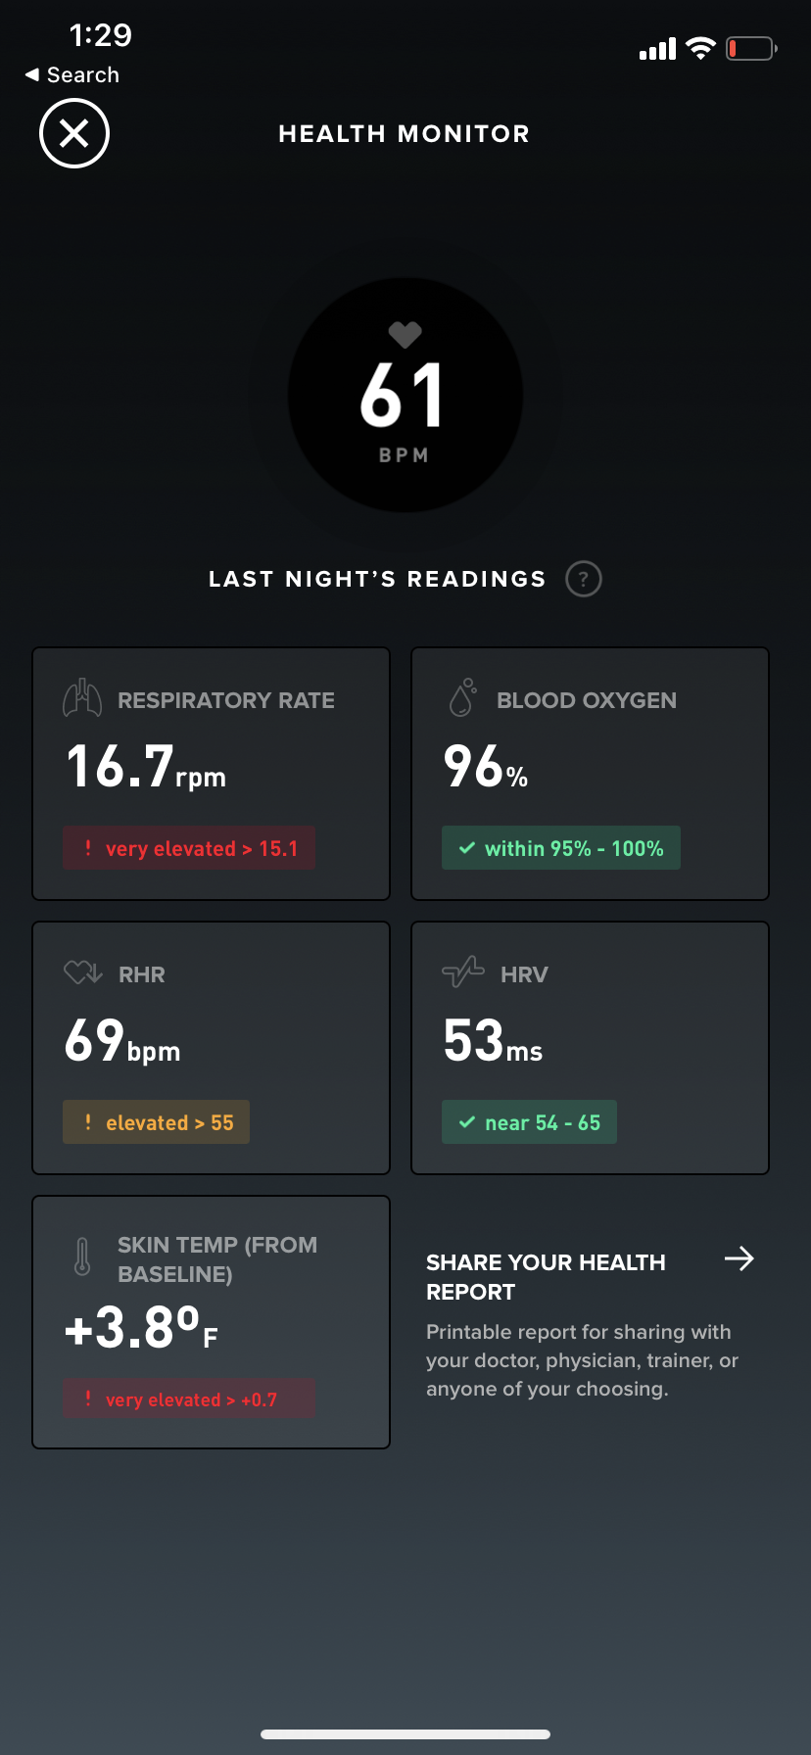
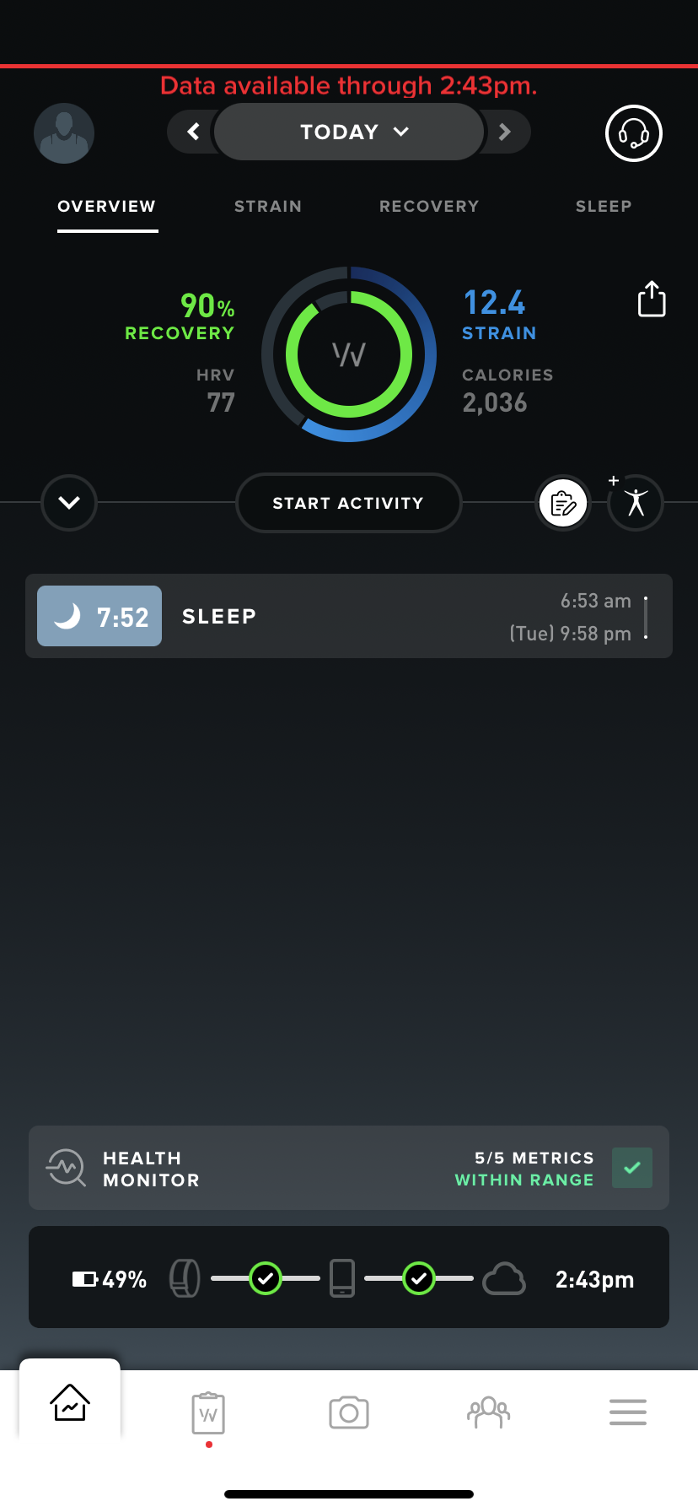

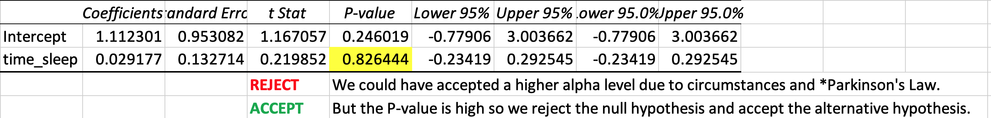
Resourcing
Resourcing
Project output and team capacity reduced:
Reason: COVID Illness
Programmer Matt
Sleep Data from Whoop
Data Analyst
Matt
SMALL
Project Manager
Matt
Date | time_sleep | proj_hrs
Visuals UI Designer
Matt
2022-09-05 00:00:00 | 5.11 | 0 | LABOR DAY (Covid)
2022-09-06 00:00:00 | 10.13 | 0 | Covid
2022-09-07 00:00:00 | 7.52 | 0 | Covid
2022-09-08 00:00:00 | 4.4 | 6 | Covid - 65% capacity
2022-09-09 00:00:00 | 5.08 | 1.5 | Covid - 5% capacity
2022-09-10 00:00:00 | 8.23 | 2.5 | 15% capacity
2022-09-11 00:00:00 | 3.1 | 0.5 | 35% capacity
2022-09-12 00:00:00 | 4.23 | 7.5 | 45% capacity
2022-09-13 00:00:00 | 7 | 8 | 65% capacity
Stock Market Researcher
Matt

Slide 13
Project #2 | 311 Non-Emergency Services (City of San Diego
Class | IST 736 – Text Mining
Date | September 2021
 | https://github.com/sudz4/syracuse-data-science/blob/c5d096d5ca7f79572f16ae82a820601122427972/proj_2.ipynb

Slide 14
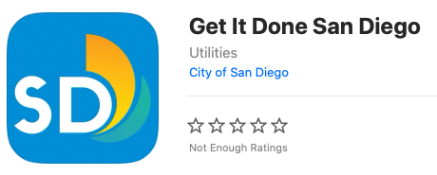
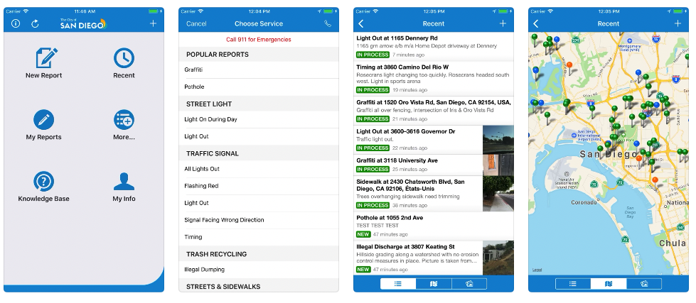
Map Data Project Overview Data Source
Problem / Challenges
Not part of a school project.
It was part of a business use case I was proposing to work leadership and explain the need for increased headcount on my team.
I could not find a function anywhere in “open-source land”, so I wrote the math out literally as code.
Then I created my own functions to interact with it.
Outcomes
I still do not have headcount for my team.
I learned a tremendous amount about numbers and the often, cold hard truth that in theory should make decision-making easier.

Slide 15
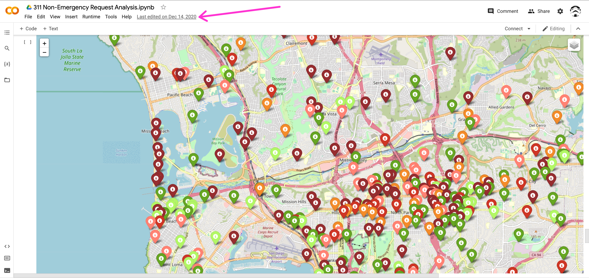
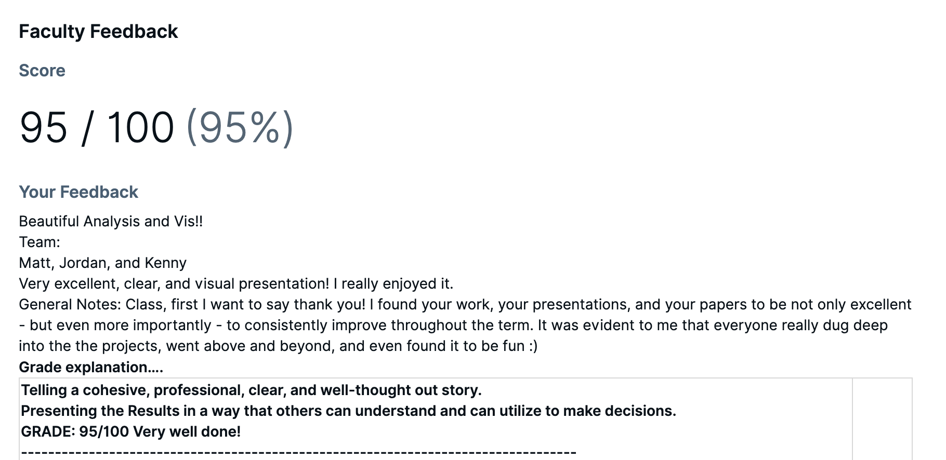

Slide 16
DEMO

Slide 17

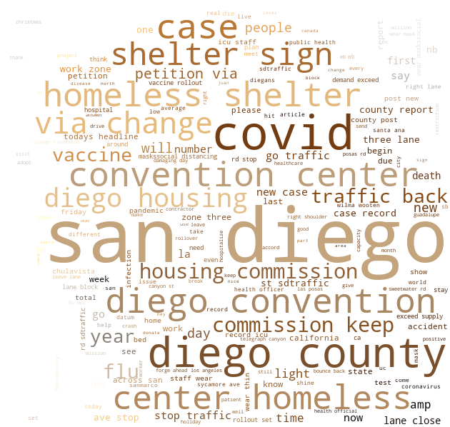

Interesting Insights Natural Language Processing - (311 Requests)
Problem / Challenges
Latitude and longitude data for requests can be analyzed and then plotted on a map.
It is important to specify that latitude and longitude does not equal zero.
Requests that are missing data are plotted at what cartographers affectionately have labeled “null island”.
Null island is located at 0,0 and located in the Gulf of Guinea off the west coast of Africa. Requests with no location data will be filtered out of the data set.
I used this picture in a small program to create a word cloud. To pick up the colors and create the word cloud.

Slide 18
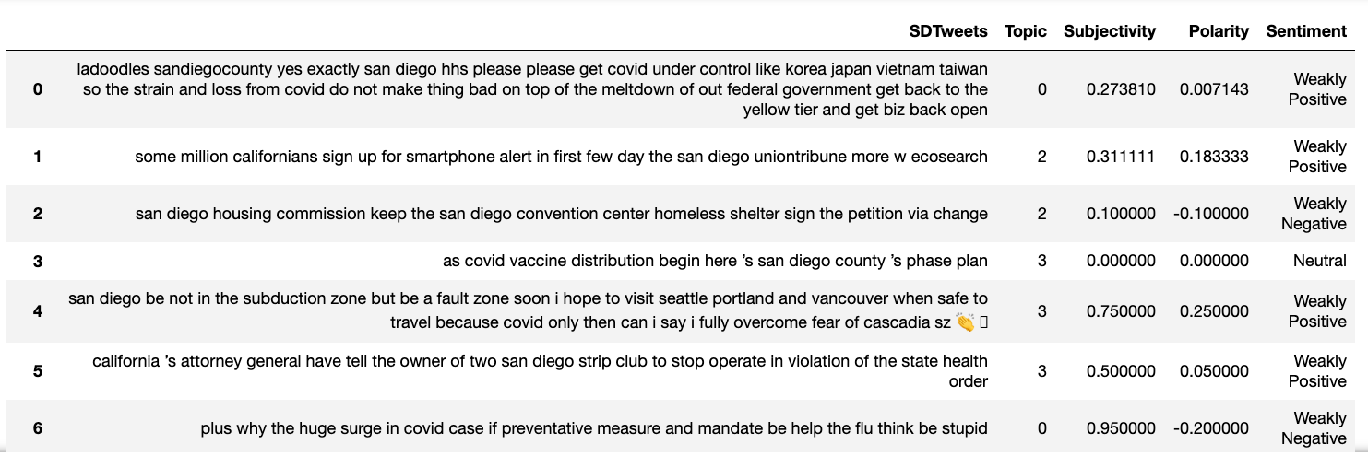

Interesting Insights Natural Language Processing - (Twitter)
Out of the five topics the Latent Dirichlet Allocation model yielded, topic #4 seemed the most relevant to a non-emergency service request, while the others appeared as noise.
Words like “sdtraffic,” “close,” and “stop,” indicate that there may have been a malfunctioning traffic light or another issue that might require city services.
Cross-Referencing San Diego @ sentiment with 311 REQUESTS sentiment.

Slide 19
Project #3 | 2020 Presidential Election Twitter Sentiment Analysis
Class | IST 664 – Natural Language Processing
Date | September 2021

Slide 20

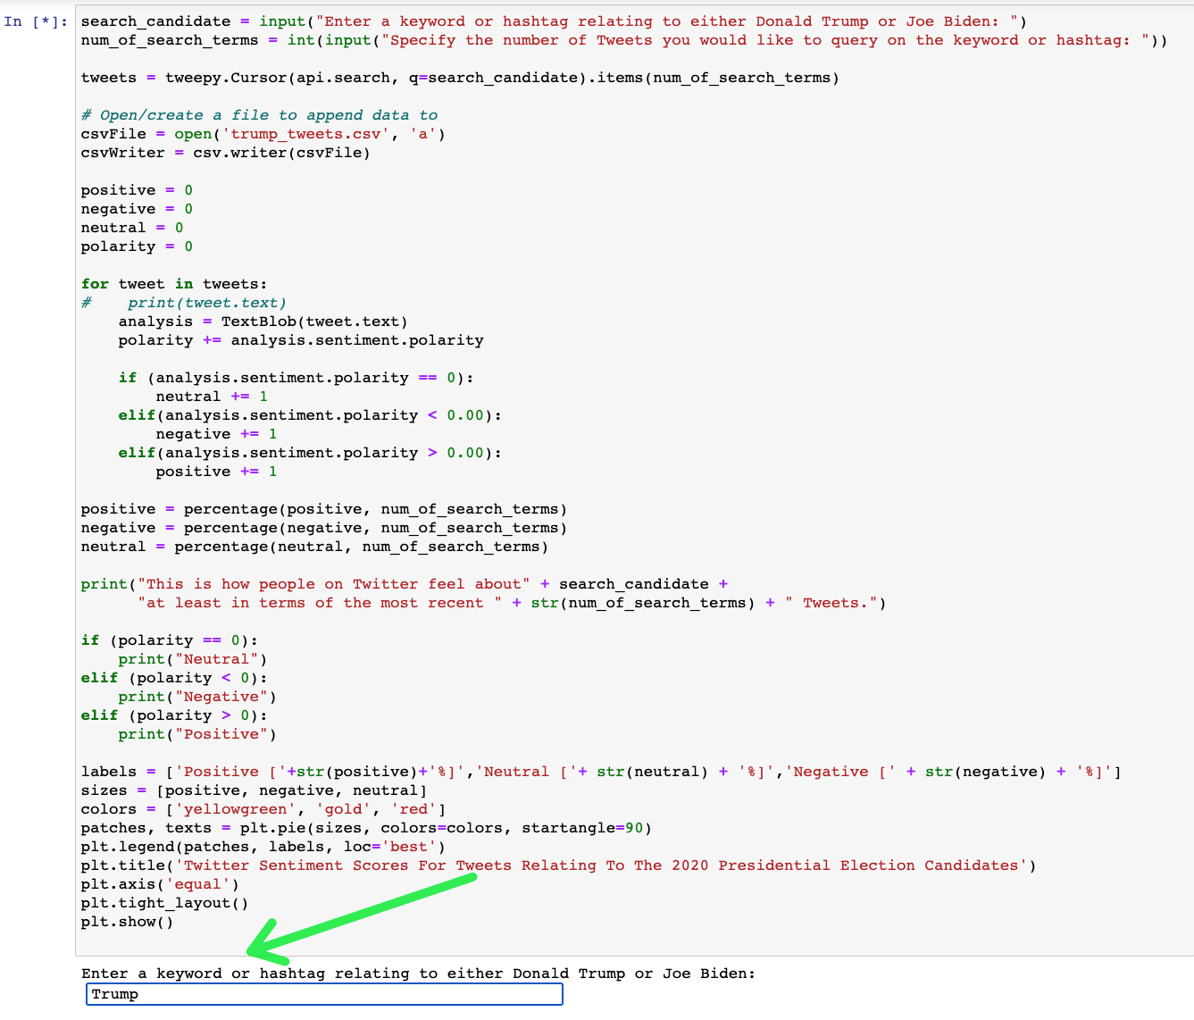
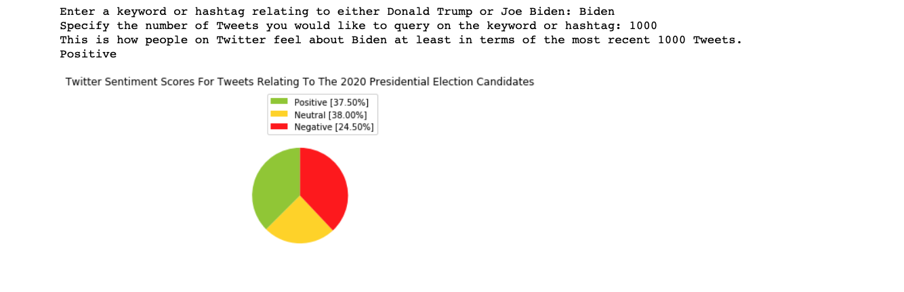
Twitter Sentiment Analysis Data Sources and User Input Example
Problem / Challenges
Information overload from the media.
What are “the people” really saying, which candidate do people like more in 280 characters or less?
Further Development Plans?
Maybe
Incorporate into stock trading models to determine public sentiment on a stock,
or a collection of stocks,
maybe a collection of stocks within a specific industry vertical.

Slide 21
Project #4 | “Bridging The Gap” – Learning to Practice
Class | N/A with influence from MBC 638 – Data Analysis and Decision Making
Date | September 2022
 | https://github.com/sudz4/syracuse-data-science/blob/6c13adbd2a0f9ecde87f6bae579ab786479ffdac/proj_4.ipynb

Slide 22
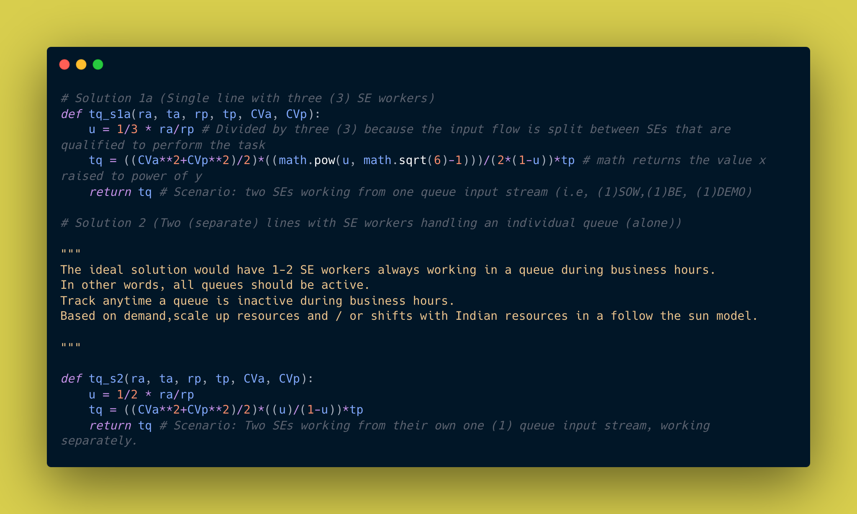
Queuing Theory Math
Problem / Challenges
Not part of a school project.
It was part of a business use case I was proposing to work leadership and explain the need for increased headcount on my team.
I could not find a function anywhere in “open-source land”, so I wrote the math out literally as code.
Then I created my own functions to interact with it.
Outcomes
I still do not have headcount for my team.
I learned a tremendous amount about numbers and the often, cold hard truth that in theory should make decision-making easier.

Slide 23
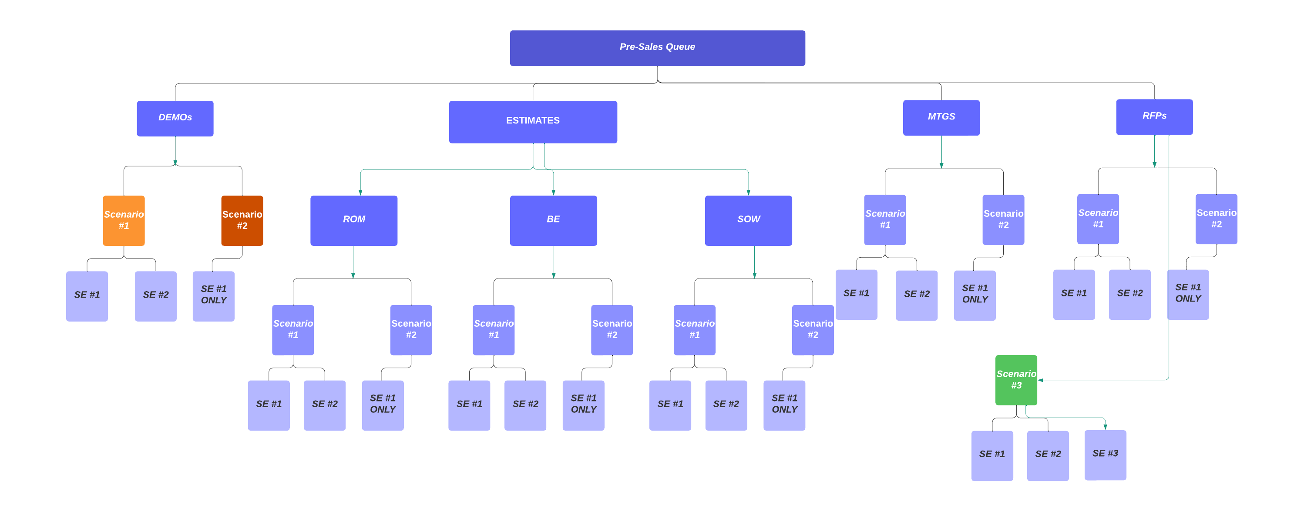

Slide 24
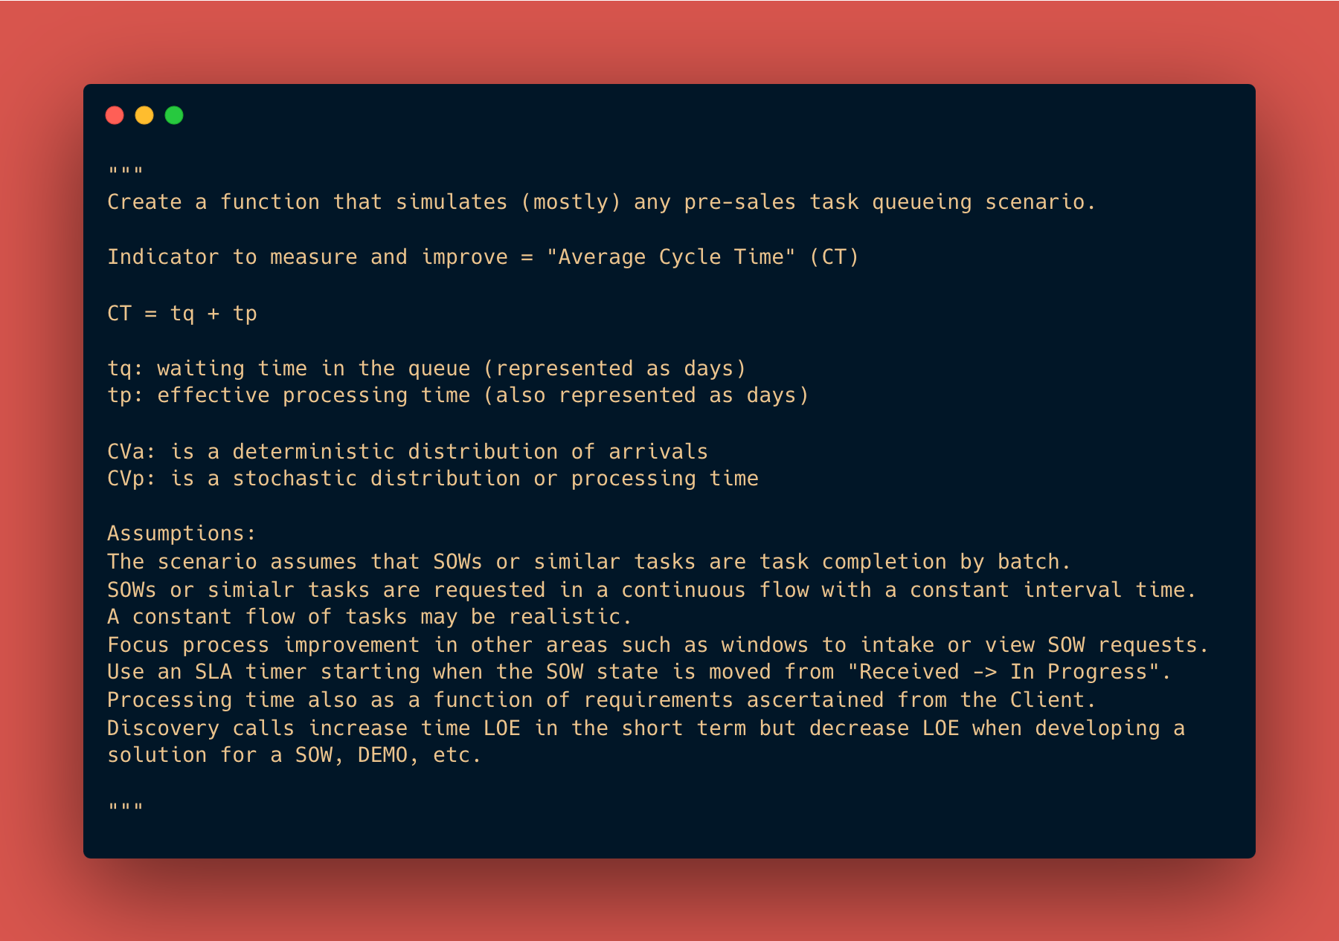
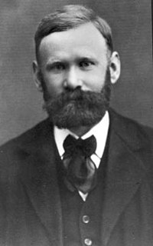
Agner Krarup Erlang (1 January 1878 – 3 February 1929)
Queueing Theory
Agner was a Danish mathematician, statistician, and engineer, who invented the fields of traffic engineering and queueing theory.

Slide 25
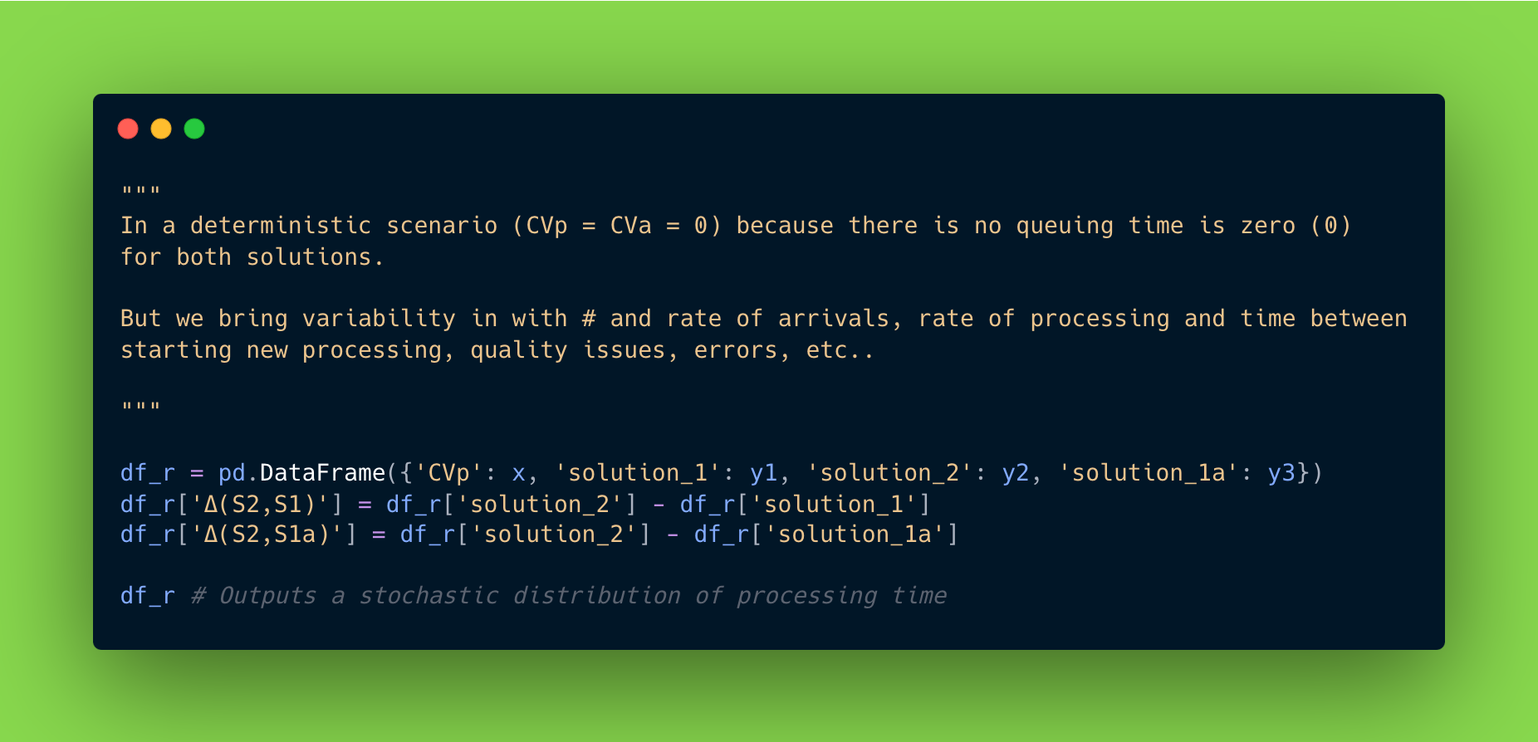

Slide 26
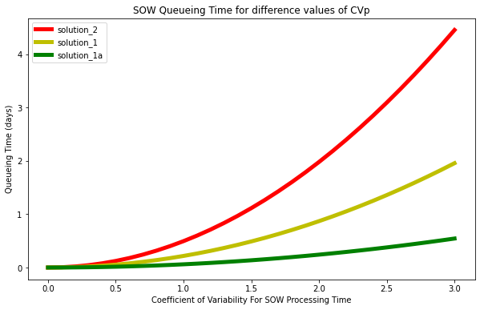
Output
Simplified Outcome
There are six (6) workstreams that my team works through (queues).
Each of those queues can quickly create bottlenecks.
I looked at Cycle time as a function of:
Pre-Sales Engineer (worker) skill set and the type of workstream to calculate cycle time.
The main idea however is that output exponentially increases when the queues are staffed appropriately -> leading to ${x} in revenue. All while accounting for margin of error, time of year, and other factors.
I have put this project on pause with relation to more complex modeling to focus on other programs related to stock market modelling.

Slide 27
Pre-Sales (SE) Task Queue Simulation Model Parameters (Model Assumptions)
Arrivals
2 SOWs
(desired outcome: INCREASE arrivals)
1/2 day between the arrival of two new tasks
(desired outcome: INCREASE time between arrivals)
SOW Process
3 days to complete a SOW
(desired outcome: DECREASE time to complete SOWs)
1/3 day between completing a SOW and starting a new SOW
(desired outcome: DECREASE the time between finishing and starting a new SOW)

Slide 28
Project #5 | My “CI/CD” Pipeline for - Continuous Improvement / Continuous Development
Class | N/A
Date | Fall 2019 - Present

Slide 29
Technology Workflows
SUBSCRIPTION
ENTITLEMENT
IT Service Management
Strategic Portfolio Management
IT Operations Management
Integrated Risk Management
Standard
Professional ¹
Standard
Application Portfolio Management
Professional ¹
ITOM Discovery
Standard
Enterprise ²
Incident
Continual Improvement
Project Portfolio
Application Portfolio Management
ITOM Visibility
Discovery
Policy and Compliance
Advanced Risk
Change
DevOps Change Velocity
Demand
ITOM Health
App Engine Starter 5
Audit
Release
Resource
PA for APM
PA for ITOM
Risk
Policy and Compliance Management
Vendor Manager - Workspace
Predictive Intelligence
Problem
Financial Planning
Spokes and Protocols
PA for Risk
Policy and Compliance Management
Financial Modeling
PA for ITBM
Digital Portfolio Management
App Engine Starter 5
App Engine Starter 5
Request
Mobile Publishing
App Engine Starter 5
Asset
Predictive Intelligence
Innovation Mgmt
App Engine Starter 5
AIOps Enterprise ²
Professional ¹
Cost
Virtual Agent
App Engine Starter 5
Advanced Audit
Privacy Management
Professional ¹
Agile Team
Health Log Analytics
Walk-Up Experience
PA for ITSM
ITOM Governance
Use Cases
Privacy Management
Universal Request
Universal Request Pro
Scaled Agile Framework (SAFe)
Agile Development
Advanced Risk ³
App Engine Starter 5
Digital Portfolio Management
App Engine Starter 50
Investment Funding
Test
ITOM – IoT Professional
Regulatory Change
DevOps Config
Agile Development
ITOM Visibility
GRC: Metrics
App Engine Starter 25
Enterprise ²
Test Management
ITOM Health
Release
PA for ITOM
Predictive Intelligence
Professional Plus ¹
Workforce Optimization
Predictive Intelligence
App Engine Starter 5
Virtual Agent
Virtual Agent Optimize
Process Optimization
Virtual Agent
¹ Professional Subscriptions contain all Entitlements in Standard Subscriptions
² Enterprise Subscriptions contain all Entitlements in Professional and Standard Subscriptions
³ IRM Professional includes limited features of Advanced Risk

Slide 30


Customer and Industry Workflows (cont.)
SUBSCRIPTION
ENTITLEMENT
Field Service Management
Healthcare and Life Sciences Service Management
Technology Provider Service Management
Telecommunications Service Operations Management
Standard
Contractor
Standard
Professional¹
Standard
Professional¹
TSOM Standard
Field Service Mgmt
Contractor Mgmt
HCLS Core
HCLS Applications
Customer Service
Universal Request Pro
Telecommunications Service Operations Management Applications and Data Model
Cost
Schedule Optimization
Customer Service
Outsourced Customer Service
Incident
Outsourced Customer Service
Asset
Schedule Optimization
Incident
Proactive Customer Service Operations
Problem
Proactive Customer Service Operations
ITOM Health
Planned Maintenance
Problem
Change
Continual Improvement Mgmt
App Engine Starter 5
Contractor Mgmt
Change
Continual Improvement Mgmt
Release
Universal Request
Release
Vendor Manager Workspace
Cost
Vendor Manager Workspace
TSOM Professional¹
App Engine Starter 5
Cost
DevOps Change Velocity
Asset
Mobile Publishing
PA for TSOM
Professional ¹
Asset
Mobile Publishing
Request
DevOps Change Velocity
ITOM Visibility
Universal Request Pro
Request
Universal Request Pro
Communities
DevOps Config
App Engine Studio
Communities
DevOps Config
Walk-Up Experience
App Engine Studio
Order Management for Telecommunications
Predictive Intelligence
Walk-Up Experience
App Engine Studio
Engagement Messenger
PA for CSM
Order Management for Telecom, Media & Tech
Virtual Agent
Engagement Messenger
PA for CSM
Digital Portfolio Management
Predictive Intelligence
PA for FSM
Digital Portfolio Management
Predictive Intelligence
Universal Request
App Engine Starter 25
Order Management
Continual Improvement Management
Universal Request
App Engine Starter 25
App Engine Starter 25
Enterprise²
App Engine Starter 100
Enterprise²
Workforce Optimization
App Engine Starter 25
Workforce Optimization
Process Optimization
Planned Work Mgmt
Process Optimization
App Engine 1,000
Advanced Dispatch
App Engine 1,000
¹ Professional Subscriptions contain all Entitlements in Standard Subscriptions
² Enterprise Subscriptions contain all Entitlements in Professional and Standard Subscriptions

Slide 31

Entitlements: Public Sector Digital Services (PSDS)
SUBSCRIPTION
Public Sector Digital Services (PSDS)
^{Entitlements}
ENTITLEMENT
Standard
Professional
Enterprise
Platform
Customer Service Management (CSM)
Platform Interfaces
Universal Request Pro
Workforce Optimization
Conversational
Incident Management
Outsourced Customer Service
Process Optimization
Mobile
Problem Management
Proactive Customer Service Operations
2,000/400
Portal Visits per month (per fulfiller/unrestricted user
Government Service Management (GSM) Portal
Change Management
Release Management
Continual Improvement Management
Workspaces
Cost Management
Vendor Manager Workspace
1,000
App Engine Custom Tables
Web Services (API)
Asset Management
Core Platform Capabilities
Request Management
Mobile Publishing
DevOps Change Velocity
CMDB
Communities
CSDM
Walk-Up Experience
App Engine Studio
Knowledge Management
Performance Analytics
Service Catalog
Engagement Messenger
Predictive Intelligence
Digital Portfolio Management
Virtual Agent
Service Level Management (SLAs)
Public Sector Digital Services Core
2,000/400
Portal Visits per month (per fulfiller/unrestricted user
Notifications
Universal Request
Reporting
Surveys & Assessments
1,000/200
Portal Visits per month (per fulfiller/unrestricted user
100
App Engine Custom Tables
Platform Security & Administration
25
App Engine Custom Tables
Authentication
Instance Security Center
Subscription Management
¹ Professional Subscriptions contain all Entitlements in Standard Subscriptions ² Enterprise Subscriptions contain all Entitlements in Professional and Standard Subscriptions

Slide 32
DEMO

Slide 33
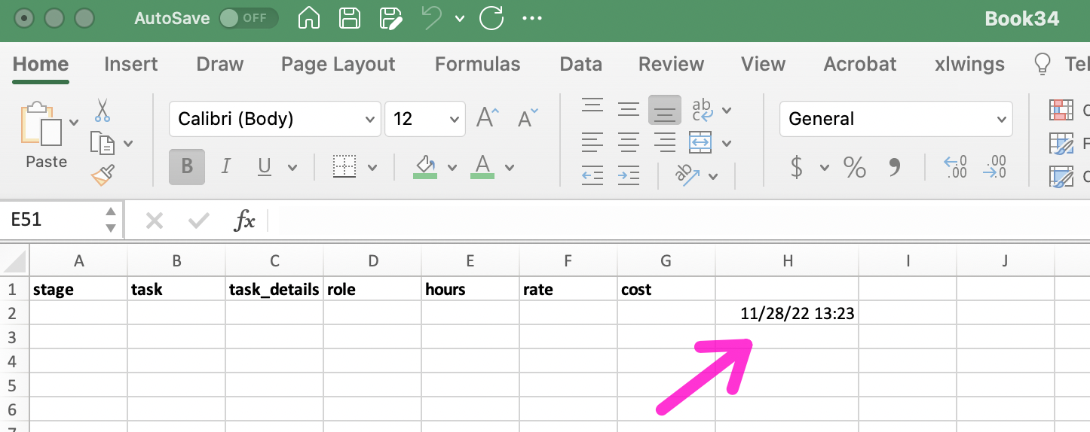
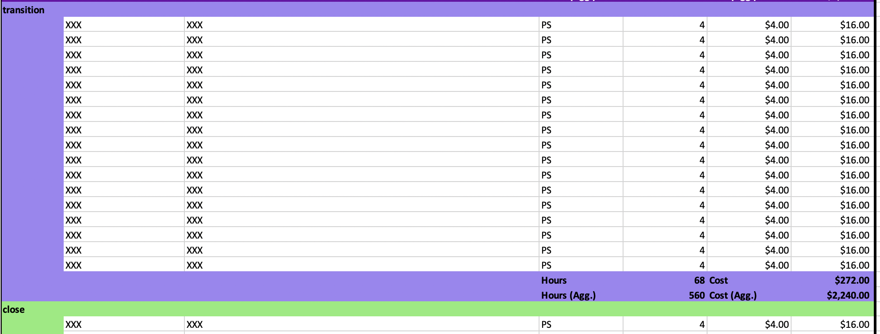
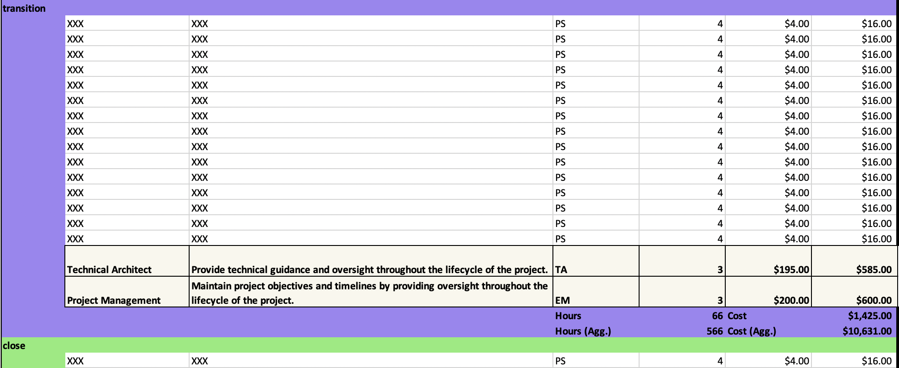
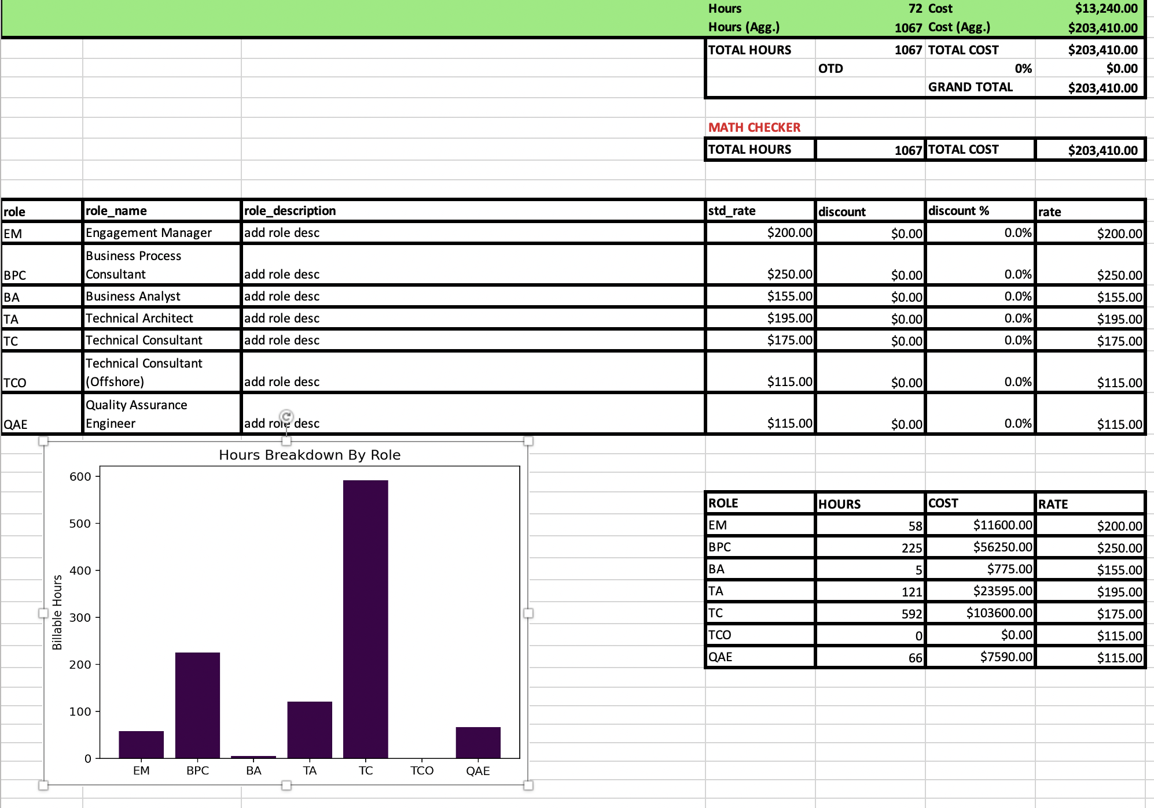
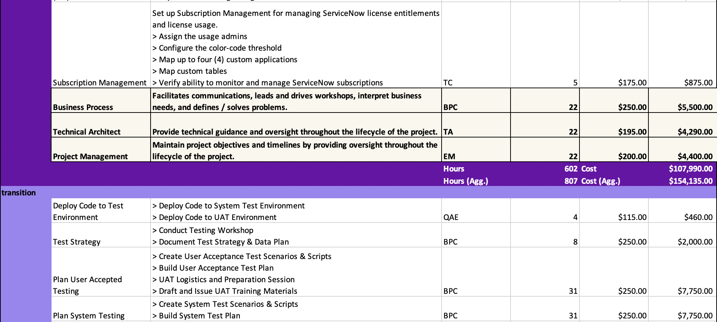
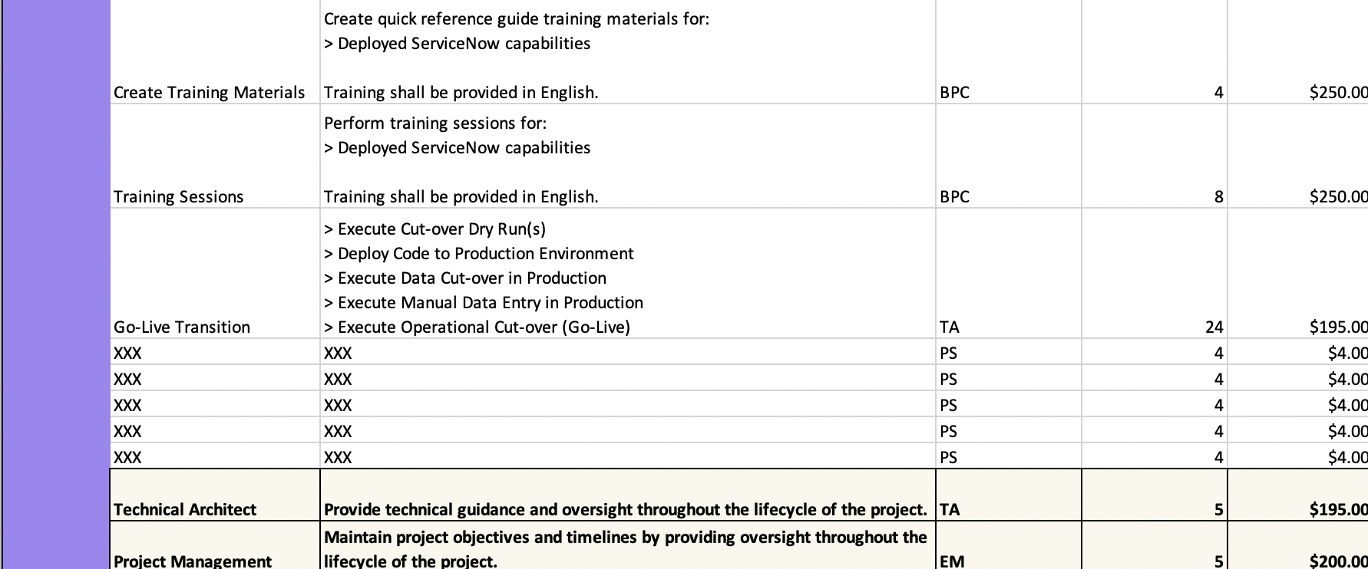
Statement of Work (SOW ) Project Scoping Automation
1 – ”Hello World”
Connect Excel Workbook with Python
2 – ”Template Setup”
Create boiler plate project template data
3 – ”Add Overlays”
Overlay project roles (i.e., Project Manager, Business Process Consultant, Solution Architect)
7 – ”Charts”
Add visualizations to communicate resource allocation, cost by role, hours by role, project duration.
4 – ”Add Baseline Tasks”
Add baseline tasks required for any type of project (i.e., instance setup and configuration, testing, knowledge transfer, training)
5 – ”Insert Project Scope”
Insert a dynamic project scope based on the Customer requirements / use case cases
6 – ”Cleanup”
Cleanup placeholder values and N/As etc.

Slide 34
Project X | Older Programs
Class | N/A
Date | 2019 & 2021

Slide 35
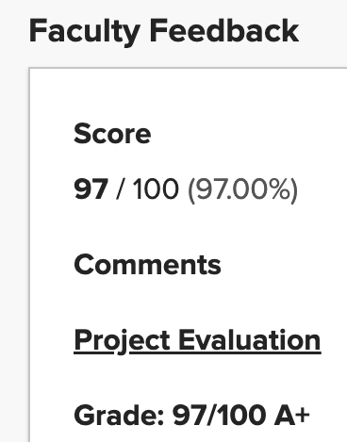
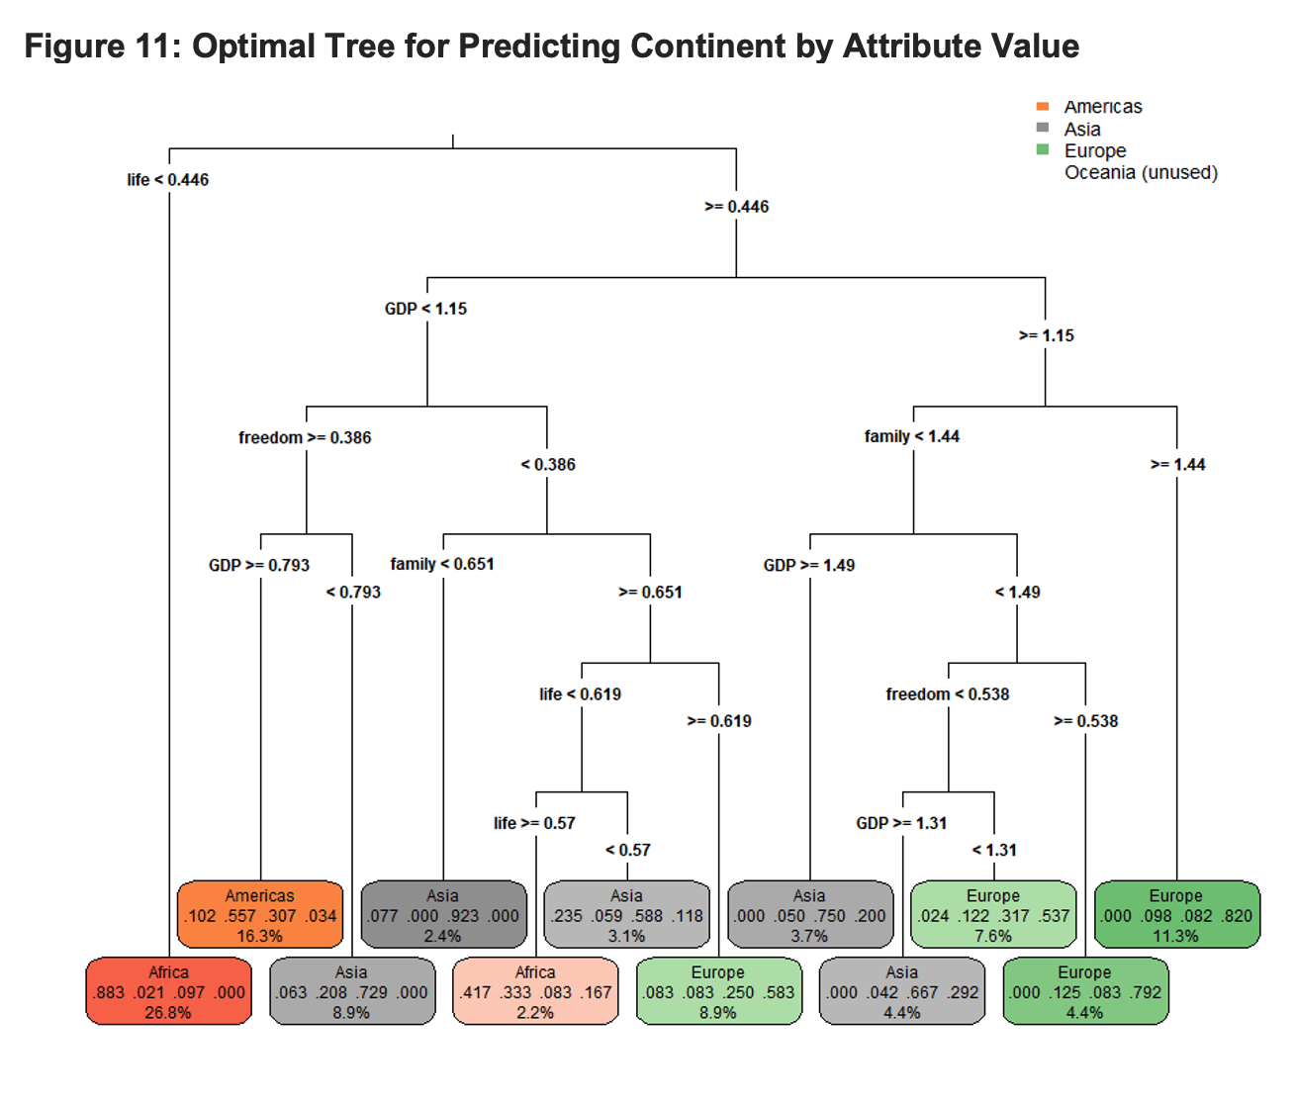

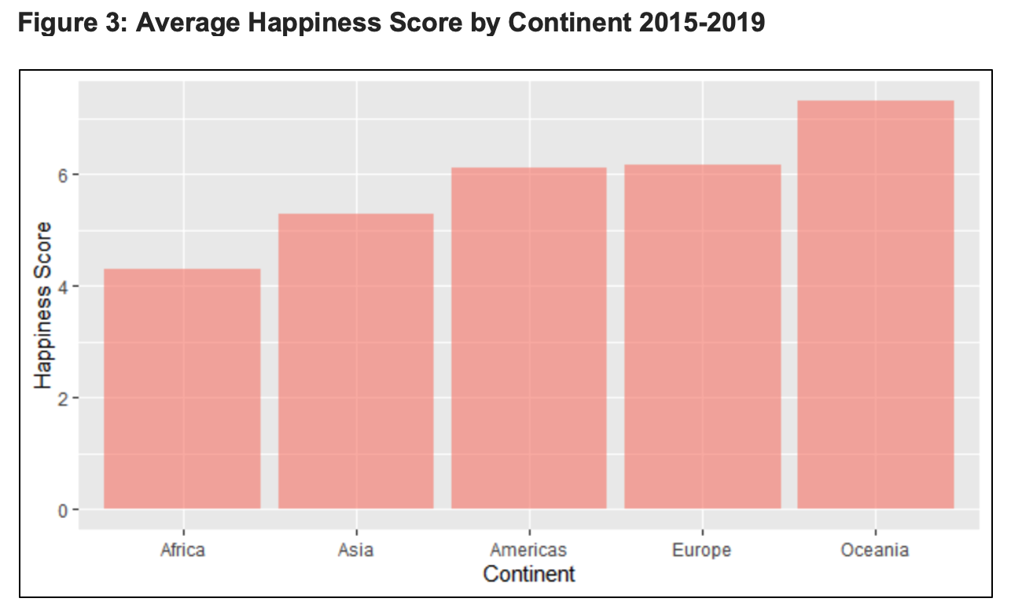
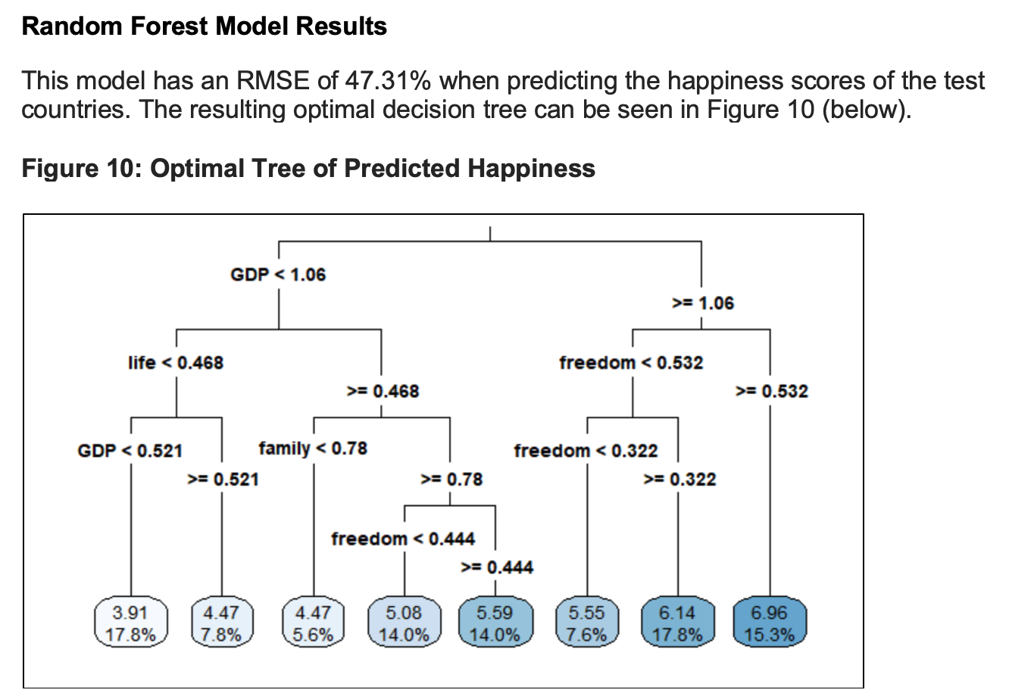
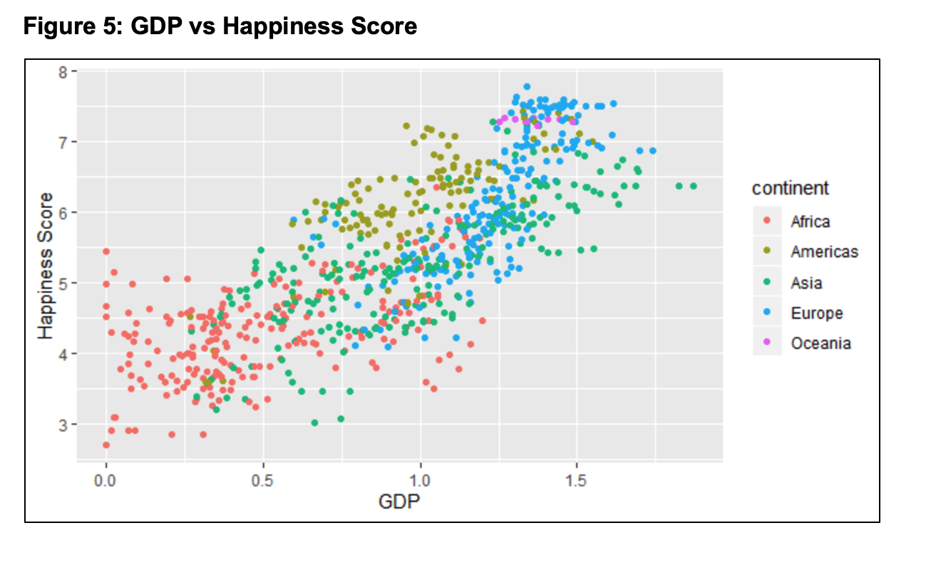
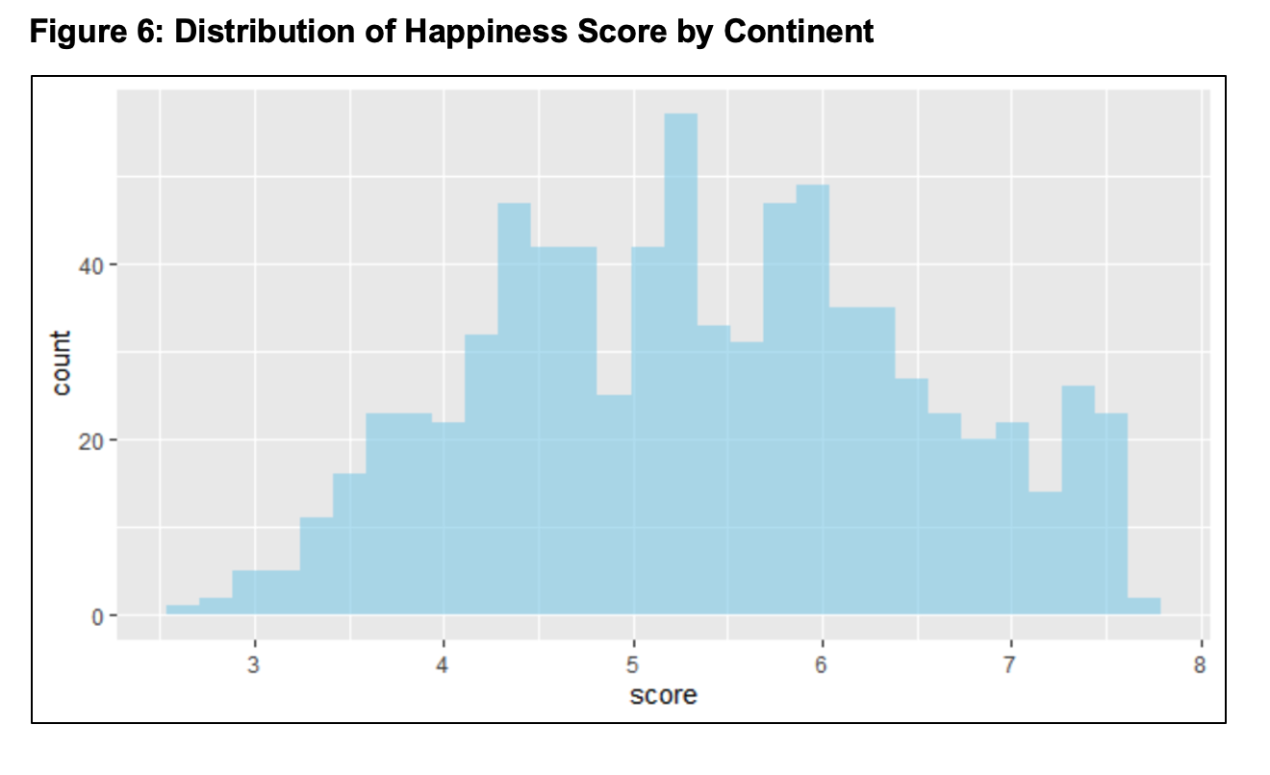
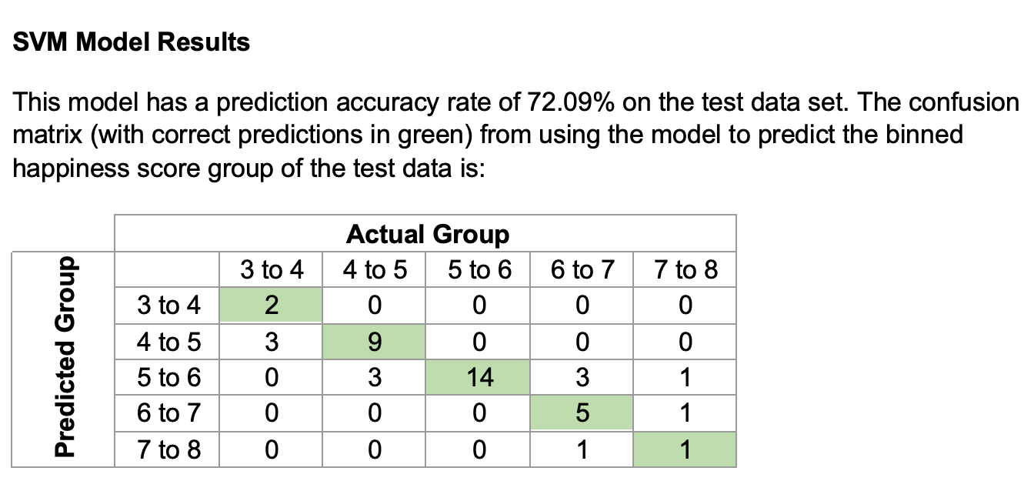
World Happiness Data Analysis
 | Rank | Score | GDP | Family | Life | Freedom | Corrupt. | Gen.
Min | 1.0 | 2.693 | 0.0000 | 0.0000 | 0.0000 | 0.0000 | 0.0000 | 0.0000
1st Qu | 40.0 | 4.510 | 0.6065 | 0.8694 | 0.4402 | 0.3098 | 0.0540 | 0.1300
Median | 79.0 | 5.322 | 0.9822 | 1.1247 | 0.6473 | 0.4310 | 0.0910 | 0.2020
Mean | 78.7 | 5.379 | 0.9160 | 1.0784 | 0.6124 | 0.4111 | 0.1254 | 0.2186
3rd Qu | 118.0 | 6.189 | 1.2362 | 1.3273 | 0.8080 | 0.5310 | 0.1560 | 0.2788
Max | 158.0 | 7.769 | 2.0960 | 1.6440 | 1.1410 | 0.7240 | 0.5519 | 0.8381
Basis For Grades:
99 - 100: This means that your Assignment was so amazing and so perfect that nothing can be improved. It covered everything – cleaning, prep – analysis that makes sense – visualizations – results (that are true) – etc. There is nothing really left to improve. I generally do not give 100% grades as this does not help you to think about what you can add or do better based on where you are. Everyone can always get better – this is why we seek education.

Slide 36
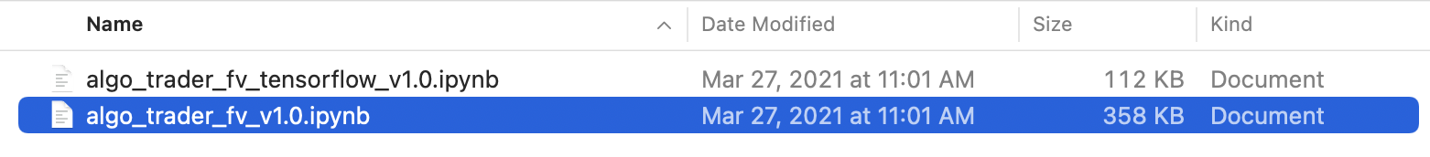
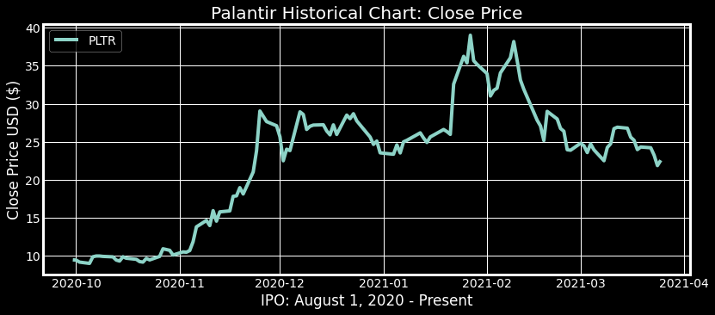



Other Old Programs for Final Projects
Learning Development
I knew I’d been working on studying the stock market for a while, but only after studying data science.
It’s been an awesome journey.
To be honest I like the visual colors here better than the ones in my more recent programs. I’ll have to look back at parts of this.

Slide 37
END OF PROGRAM

